Slide 1
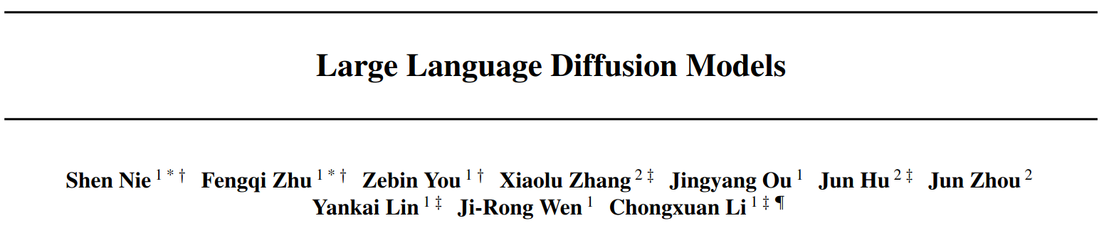
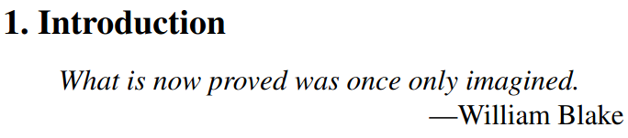
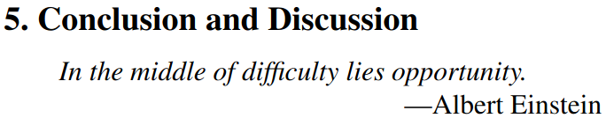

Slide 2
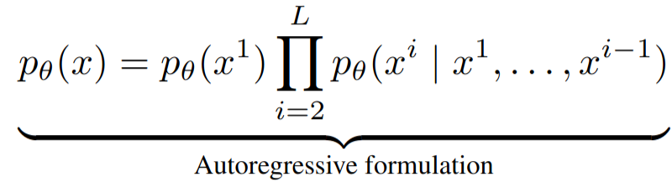
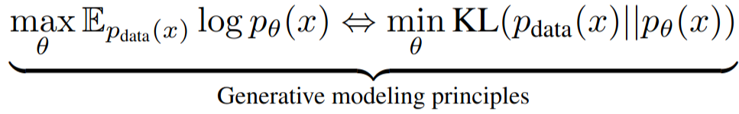
TL;DR
Autoregressive models (ARMs) are the current standard for LLMS
But other paradigms, e.g. diffusion, should (theoretically) be able to work just as well at generative modelling:
The authors create a LLaMA3 8B-like diffusion model (“LLaDa 8B”) and achieve comparable (or slightly better?) performance, with seemingly decent scaling

Slide 3
TL;DR
Autoregressive models (ARMs) are the current standard for LLMS
But other paradigms, e.g. diffusion, should (theoretically) be able to work just as well at generative modelling:
The authors create a LLaMA3 8B-like diffusion model (“LLaDa 8B”) and achieve comparable (or slightly better?) performance, with seemingly decent scaling

Slide 4
TL;DR
Autoregressive models (ARMs) are the current standard for LLMS
But other paradigms, e.g. diffusion, should (theoretically) be able to work just as well at generative modelling:
The authors create a Llama8B-like diffusion model (“LLaDa 8B”) and achieve comparable (or slightly better?) performance, with seemingly decent scaling

Slide 5
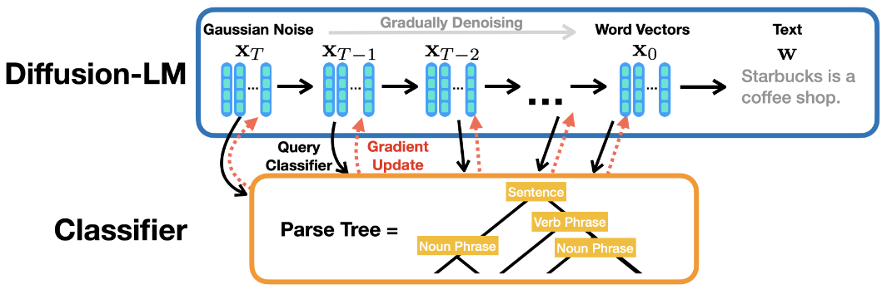
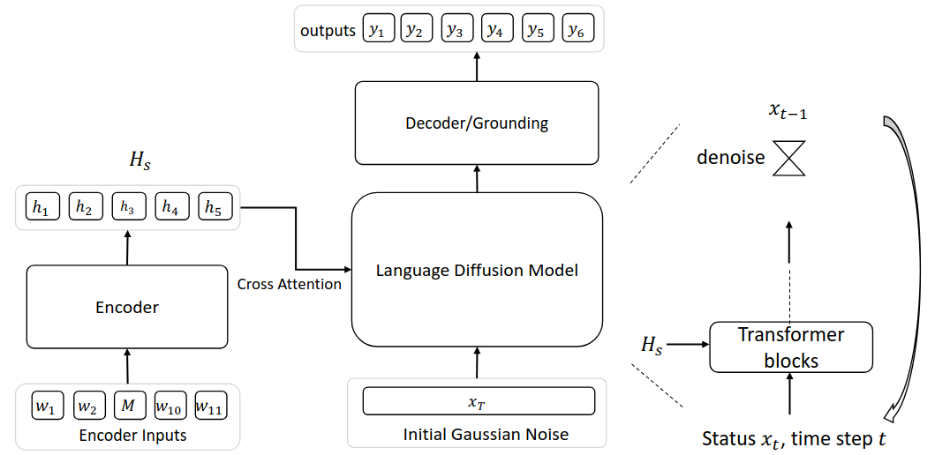
Why hasn’t this been done before?
Diffusion has been used in NLP before, but isn’t usually great or scalable
Have to convert from continuous latent variables to discrete tokens
Leads to weird things like “Diffusion-LM” (Li et al., 2022) where you’re generating conditioned on specific grammatical structure
Or to very complicated diffusion models that work on a continuous version of discrete space,e.g. “DINOISER”, (Ye et al., 2023), or “GENIE” (Lin et al., 2023).
Hard to scale this up
“Language Modeling is Compression” (Deletang et al., 2024), shows a 1B model like this required 64x the compute as a 1B ARM (according to this paper’s interpretation)
“Diffusion-LM Improves Controllable Text Generation”, Li et al. (2023)
GENIE: “Text Generation with Diffusion Language Models: A Pre-training Approach with Continuous Paragraph Denoise”, Lin et al. (2023)

Slide 6
Why hasn’t this been done before?
Diffusion has been used in NLP before, but isn’t usually great or scalable
Have to convert from continuous latent variables to discrete tokens
Leads to weird things like “Diffusion-LM” (Li et al., 2022) where you’re generating conditioned on specific grammatical structure
Or to very complicated diffusion models that work on a continuous version of discrete space,e.g. “DINOISER”, (Ye et al., 2023), or “GENIE” (Lin et al., 2023).
Hard to scale this up
“Language Modeling is Compression” (Deletang et al., 2024), shows a 1B model like this required 64x the compute as a 1B ARM (according to this paper’s interpretation)
“Diffusion-LM Improves Controllable Text Generation”, Li et al. (2023)
GENIE: “Text Generation with Diffusion Language Models: A Pre-training Approach with Continuous Paragraph Denoise”, Lin et al. (2023)

Slide 7
Why hasn’t this been done before?
Diffusion has been used in NLP before, but isn’t usually great or scalable
Have to convert from continuous latent variables to discrete tokens
Leads to weird things like “Diffusion-LM” (Li et al., 2022) where you’re generating conditioned on specific grammatical structure
Or to very complicated diffusion models that work on a continuous version of discrete space,e.g. “DINOISER”, (Ye et al., 2023), or “GENIE” (Lin et al., 2023).
Hard to scale this up
“Language Modeling is Compression” (Deletang et al., 2024), shows a 1B model like this required 64x the compute as a 1B ARM (according to this paper’s interpretation)
“Diffusion-LM Improves Controllable Text Generation”, Li et al. (2023)
GENIE: “Text Generation with Diffusion Language Models: A Pre-training Approach with Continuous Paragraph Denoise”, Lin et al. (2023)

Slide 8
Why hasn’t this been done before?
Diffusion has been used in NLP before, but isn’t usually great or scalable
Have to convert from continuous latent variables to discrete tokens
Leads to weird things like “Diffusion-LM” (Li et al., 2022) where you’re generating conditioned on specific grammatical structure
Or to very complicated diffusion models that work on a continuous version of discrete space, e.g. “DINOISER”, (Ye et al., 2023), or “GENIE” (Lin et al., 2023).
Hard to scale this up
“Language Modeling is Compression” (Deletang et al., 2024), shows a 1B model like this required 64x the compute as a 1B ARM (according to this paper’s interpretation)
“Diffusion-LM Improves Controllable Text Generation”, Li et al. (2023)
GENIE: “Text Generation with Diffusion Language Models: A Pre-training Approach with Continuous Paragraph Denoise”, Lin et al. (2023)

Slide 9
Why hasn’t this been done before?
Diffusion has been used in NLP before, but isn’t usually great or scalable
Have to convert from continuous latent variables to discrete tokens
Leads to weird things like “Diffusion-LM” (Li et al., 2022) where you’re generating conditioned on specific grammatical structure
Or to very complicated diffusion models that work on a continuous version of discrete space, e.g. “DINOISER”, (Ye et al., 2023), or “GENIE” (Lin et al., 2023).
Hard to scale this up
“Language Modeling is Compression” (Deletang et al., 2024), shows a 1B model like this required 64x the compute as a 1B ARM (according to this paper’s interpretation)
“Diffusion-LM Improves Controllable Text Generation”, Li et al. (2023)
GENIE: “Text Generation with Diffusion Language Models: A Pre-training Approach with Continuous Paragraph Denoise”, Lin et al. (2023)

Slide 10
Why hasn’t this been done before?
Diffusion has been used in NLP before, but isn’t usually great or scalable
Have to convert from continuous latent variables to discrete tokens
Leads to weird things like “Diffusion-LM” (Li et al., 2022) where you’re generating conditioned on specific grammatical structure
Or to very complicated diffusion models that work on a continuous version of discrete space, e.g. “DINOISER”, (Ye et al., 2023), or “GENIE” (Lin et al., 2023).
Hard to scale this up
“Language Modeling is Compression” (Deletang et al., 2024), shows a 1B model like this required 64x the compute as a 1B ARM
“Diffusion-LM Improves Controllable Text Generation”, Li et al. (2023)
GENIE: “Text Generation with Diffusion Language Models: A Pre-training Approach with Continuous Paragraph Denoise”, Lin et al. (2023)

Slide 11
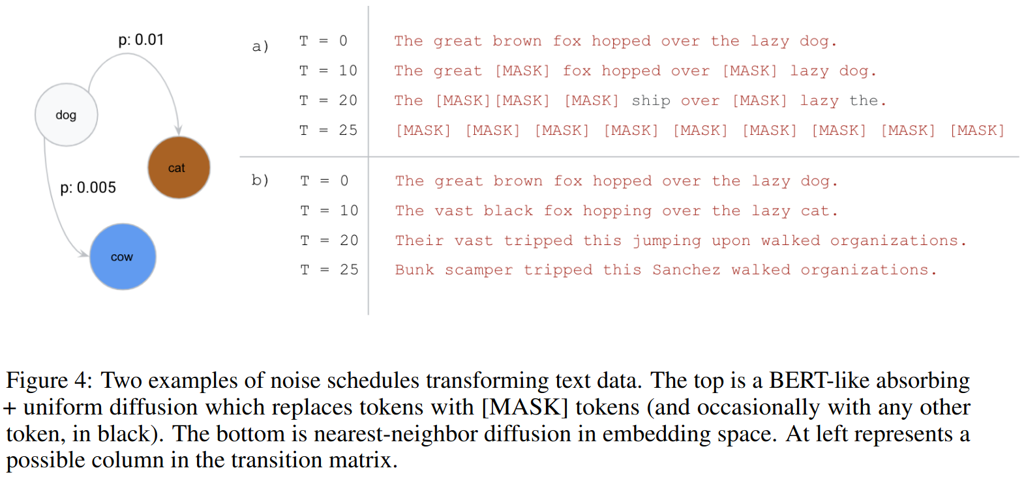
Discrete Diffusion
You could do discrete diffusion
“Structured Denoising Diffusion Models in Discrete State-Spaces” (Austin et al., 2023)
In particular, Masked Diffusion Models
“Discrete Diffusion Modeling by Estimating the Ratios of the Data Distribution” (Lou et al., 2023)
(Austin et al., 2023)

Slide 12
Discrete Diffusion
You could do discrete diffusion
“Structured Denoising Diffusion Models in Discrete State-Spaces” (Austin et al., 2023)
In particular, Masked Diffusion Models
“Discrete Diffusion Modeling by Estimating the Ratios of the Data Distribution” (Lou et al., 2023)
(Austin et al., 2023)

Slide 13
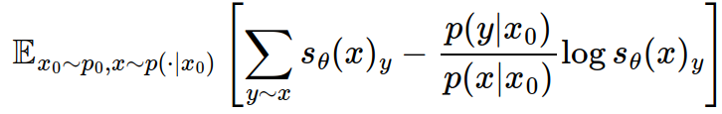
Discrete Diffusion
You could do discrete diffusion
“Structured Denoising Diffusion Models in Discrete State-Spaces” (Austin et al., 2023)
In particular, Masked Diffusion Models
“Discrete Diffusion Modeling by Estimating the Ratios of the Data Distribution” (Lou et al., 2023)
(Austin et al., 2023)
(Complicated implementation using denoising score entropy)

Slide 14
Discrete Diffusion Drawbacks
In a previous paper (Nie et al., 2024), the authors suggest you still need 16x the compute of an equivalent ARM to achieve the same likelihood
(The authors say not to worry: Diffusion optimises a bound on the likelihood, which isn’t even what you necessarily care about for downstream tasks (i.e. accuracy), so we shouldn’t write off MDMs…)
To get it to work there’s a bunch of tricks (hacks?) that have been developed over the past couple of years
Also, it’s just a bit weird…

Slide 15
Discrete Diffusion Drawbacks
In a previous paper (Nie et al., 2024), the authors suggest you still need 16x the compute of an equivalent ARM to achieve the same likelihood
(The authors say not to worry: Diffusion optimises a bound on the likelihood, which isn’t even what you necessarily care about for downstream tasks (i.e. accuracy), so we shouldn’t write off MDMs…)
To get it to work there’s a bunch of tricks (hacks?) that have been developed over the past couple of years
Also, it’s just a bit weird…

Slide 16
Discrete Diffusion Drawbacks
In a previous paper (Nie et al., 2024), the authors suggest you still need 16x the compute of an equivalent ARM to achieve the same likelihood
(The authors say not to worry: Diffusion optimises a bound on the likelihood, which isn’t even what you necessarily care about for downstream tasks (i.e. accuracy), so we shouldn’t write off MDMs…)
To get it to work there’s a bunch of tricks (hacks?) that have been developed over the past couple of years
Also, it’s just a bit weird…

Slide 17
Discrete Diffusion Drawbacks
In a previous paper (Nie et al., 2024), the authors suggest you still need 16x the compute of an equivalent ARM to achieve the same likelihood
(The authors say not to worry: Diffusion optimises a bound on the likelihood, which isn’t even what you necessarily care about for downstream tasks (i.e. accuracy), so we shouldn’t write off MDMs…)
To get it to work there’s a bunch of tricks (hacks?) that have been developed over the past couple of years
Also, it’s just a bit weird…

Slide 18
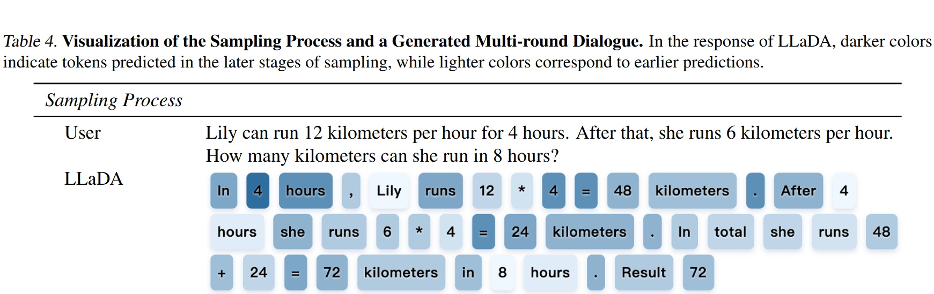
It’s kind of weird…

Slide 19
It’s kind of weird…

Slide 20
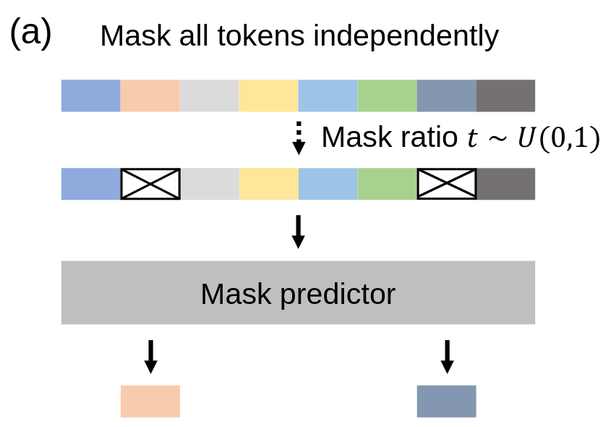
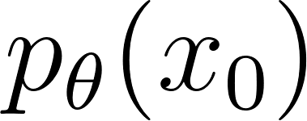
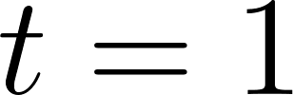
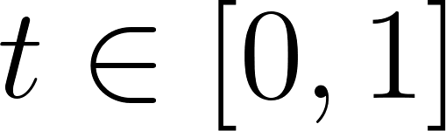
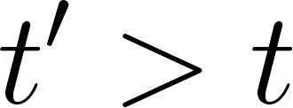
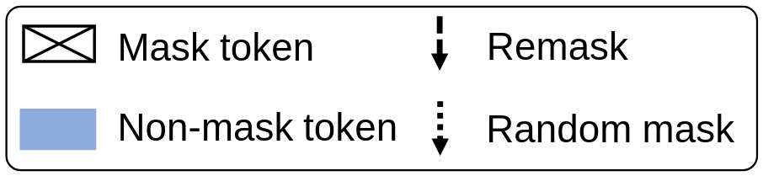
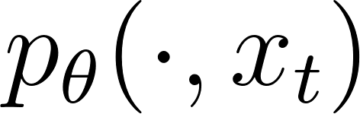
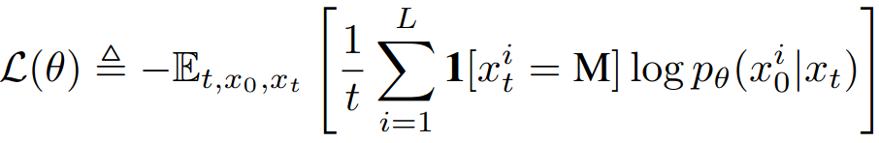

Masked Diffusion Model (MDM)
Model the data distribution with a:
forward process: gradually mask tokens (independently) until fully masked at :
At time each token is masked with prob.
(Once a token is masked it stays masked for .)
reverse process: predict masked tokens as moves from 0 to 1:
Based on a mask predictor trained with cross-entropy loss only on the masked tokens:
where , and is sampled from the forward process.

Slide 21
Masked Diffusion Model (MDM)
Model the data distribution with a:
forward process: gradually mask tokens (independently) until fully masked at :
At time each token is masked with prob.
(Once a token is masked it stays masked for .)
reverse process: predict masked tokens as moves from 0 to 1:
Based on a mask predictor trained with cross-entropy loss only on the masked tokens:
where , and is sampled from the forward process.

Slide 22
Masked Diffusion Model (MDM)
Model the data distribution with a:
forward process: gradually mask tokens (independently) until fully masked at :
At time each token is masked with prob.
(Once a token is masked it stays masked for .)
reverse process: predict masked tokens as moves from 0 to 1:
Based on a mask predictor trained with cross-entropy loss only on the masked tokens:
where , and is sampled from the forward process.

Slide 23
Masked Diffusion Model (MDM)
Model the data distribution with a:
forward process: gradually mask tokens (independently) until fully masked at :
At time each token is masked with prob.
(Once a token is masked it stays masked for .)
reverse process: predict masked tokens as moves from 0 to 1:
Based on a mask predictor trained with cross-entropy loss only on the masked tokens:
where , and is sampled from the forward process.

Slide 24
Masked Diffusion Model (MDM)
Model the data distribution with a:
forward process: gradually mask tokens (independently) until fully masked at :
At time each token is masked with prob.
(Once a token is masked it stays masked for .)
reverse process: predict masked tokens as moves from 0 to 1:
Based on a mask predictor trained with cross-entropy loss only on the masked tokens:
where , and is sampled from the forward process.

Slide 25
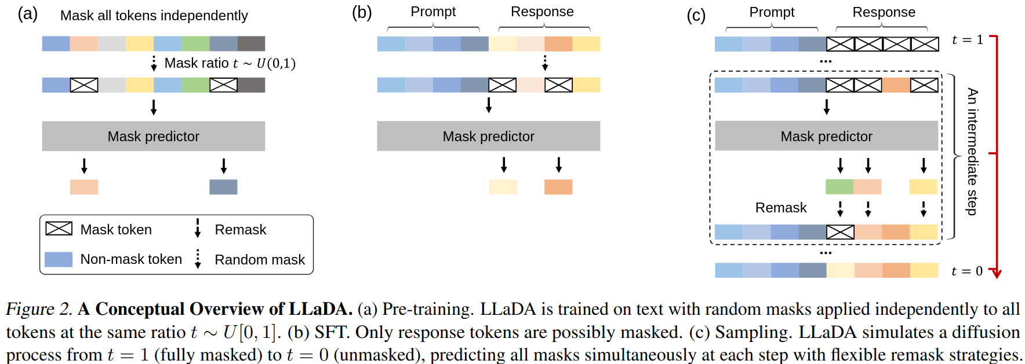
How do we apply the standard LLM pipeline?
Pretraining
SFT
Sampling

Slide 26
How do we apply the standard LLM pipeline?
Pretraining
SFT
Sampling

Slide 27
How do we apply the standard LLM pipeline?
Pretraining
SFT
Sampling

Slide 28
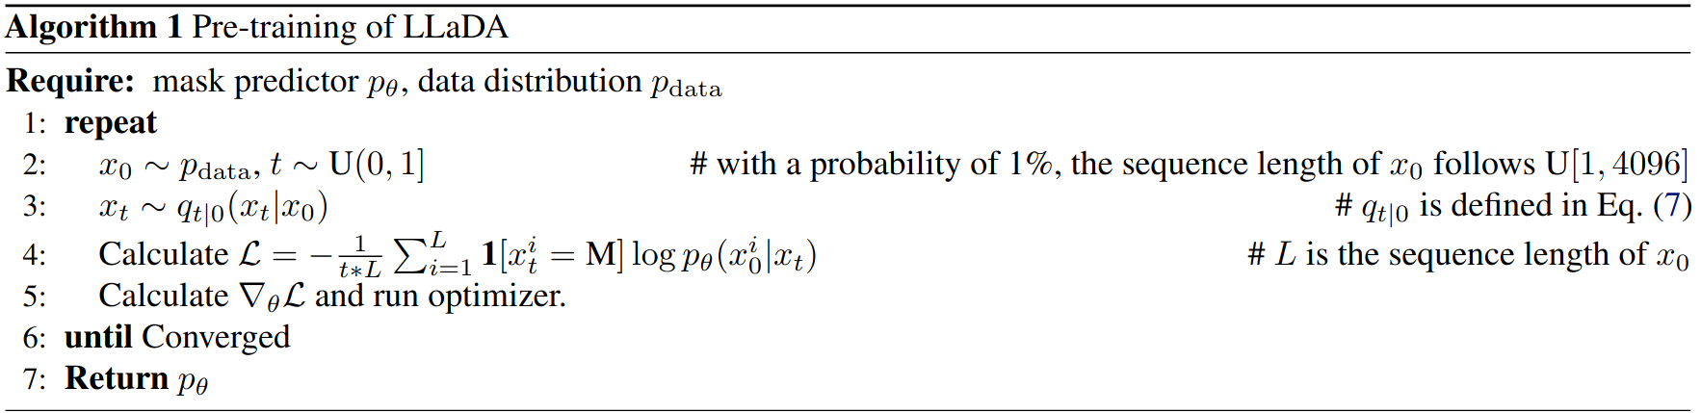
Pretraining
Train the mask predictor as we just described:
Transformer-based architecture (LLaMA3)
1B & 8B models
2.3T tokens
0.13 million H800 GPU hours (8B model)
Fixed sequence length 4096:
1% of the pre-training data is set to a (uniformly) random length in [1, 4096] to help with variable-length inputs

Slide 29
Pretraining
Train the mask predictor as we just described:
Transformer-based architecture (Llama3)
1B & 8B models
2.3T tokens
0.13 million H800 GPU hours (8B model)
Fixed sequence length 4096:
1% of the pre-training data is set to a (uniformly) random length in [1, 4096] to help with variable-length inputs

Slide 30
Pretraining
Train the mask predictor as we just described:
Transformer-based architecture (Llama3)
1B & 8B models
2.3T tokens
0.13 million H800 GPU hours (8B model)
Fixed sequence length 4096:
1% of the pre-training data is set to a (uniformly) random length in [1, 4096] to help with variable-length inputs

Slide 31
Pretraining
Train the mask predictor as we just described:
Transformer-based architecture (Llama3)
1B & 8B models
2.3T tokens
0.13 million H800 GPU hours (8B model)
Fixed sequence length 4096:
1% of the pre-training data is set to a (uniformly) random length in [1, 4096] to help with variable-length inputs

Slide 32
Pretraining
Train the mask predictor as we just described:
Transformer-based architecture (Llama3)
1B & 8B models
2.3T tokens
0.13 million H800 GPU hours (8B model)
Fixed sequence length 4096:
1% of the pre-training data is set to a (uniformly) random length in [1, 4096] to help with variable-length inputs

Slide 33
Pretraining
Train the mask predictor as we just described:
Transformer-based architecture (Llama3)
1B & 8B models
2.3T tokens
0.13 million H800 GPU hours (8B model)
Fixed sequence length 4096:
1% of the pre-training data is set to a (uniformly) random length in [1, 4096] to help with variable-length inputs

Slide 34
Pretraining
Train the mask predictor as we just described:
Transformer-based architecture (Llama3)
1B & 8B models
2.3T tokens
0.13 million H800 GPU hours (8B model)
Fixed sequence length 4096:
1% of the pre-training data is set to a (uniformly) random length in [1, 4096] to help with variable-length inputs

Slide 35
Pretraining
Train the mask predictor as we just described:
Transformer-based architecture (Llama3)
1B & 8B models
2.3T tokens
0.13 million H800 GPU hours (8B model)
Fixed sequence length 4096:
1% of the pre-training data is set to a (uniformly) random length in [1, 4096] to help with variable-length inputs

Slide 36
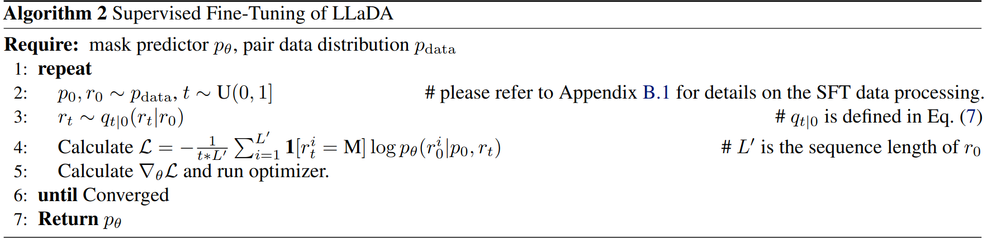



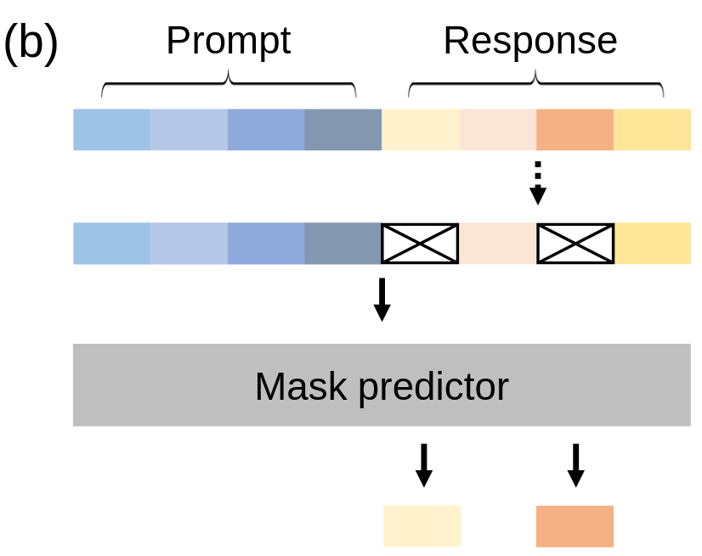
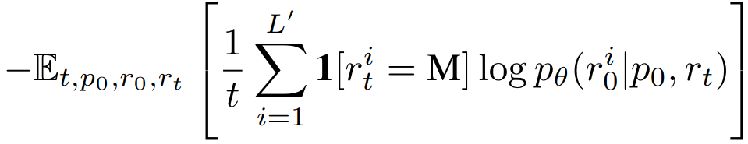
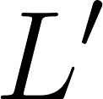

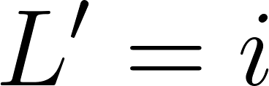
SFT
Slightly different loss (only care about response given prompt and intermediate response ):
Where is a dynamic length:
SFT training examples padded with |EOS| to get to 4096 tokens
Model is trained to generate these |EOS| tokens (they get masked in forward process)
When |EOS| sampled in reverse process for token , we set and ignore everything after (?) (slightly unclear)

Slide 37
SFT
Slightly different loss (only care about response given prompt and intermediate response ):
Where is a dynamic length:
SFT training examples padded with |EOS| to get to 4096 tokens
Model is trained to generate these |EOS| tokens (they get masked in forward process)
When |EOS| sampled in reverse process for token , we set and ignore everything after (?) (slightly unclear)

Slide 38
SFT
Slightly different loss (only care about response given prompt and intermediate response ):
Where is a dynamic length:
SFT training examples padded with |EOS| to get to 4096 tokens
Model is trained to generate these |EOS| tokens (they get masked in forward process)
When |EOS| sampled in reverse process for token , we set and ignore everything after (?) (slightly unclear)

Slide 39
SFT
Slightly different loss (only care about response given prompt and intermediate response ):
Where is a dynamic length:
SFT training examples padded with |EOS| to get to 4096 tokens
Model is trained to generate these |EOS| tokens (they get masked in forward process)
When |EOS| sampled in reverse process for token , we set and ignore everything after (?) (slightly unclear)

Slide 40
SFT
Slightly different loss (only care about response given prompt and intermediate response ):
Where is a dynamic length:
SFT training examples padded with |EOS| to get to 4096 tokens
Model is trained to generate these |EOS| tokens (they get masked in forward process)
When |EOS| sampled in reverse process for token , we set and ignore everything after (?) (slightly unclear)

Slide 41
SFT
Slightly different loss (only care about response given prompt and intermediate response ):
Where is a dynamic length:
SFT training examples padded with |EOS| to get to 4096 tokens
Model is trained to generate these |EOS| tokens (they get masked in forward process)
When |EOS| sampled in reverse process for token , we delete it and decrease by 1.

Slide 42
SFT
Slightly different loss (only care about response given prompt and intermediate response ):
Where is a dynamic length:
SFT training examples padded with |EOS| to get to 4096 tokens
Model is trained to generate these |EOS| tokens (they get masked in forward process)
When |EOS| sampled in reverse process for token , we delete it and decrease by 1.

Slide 43
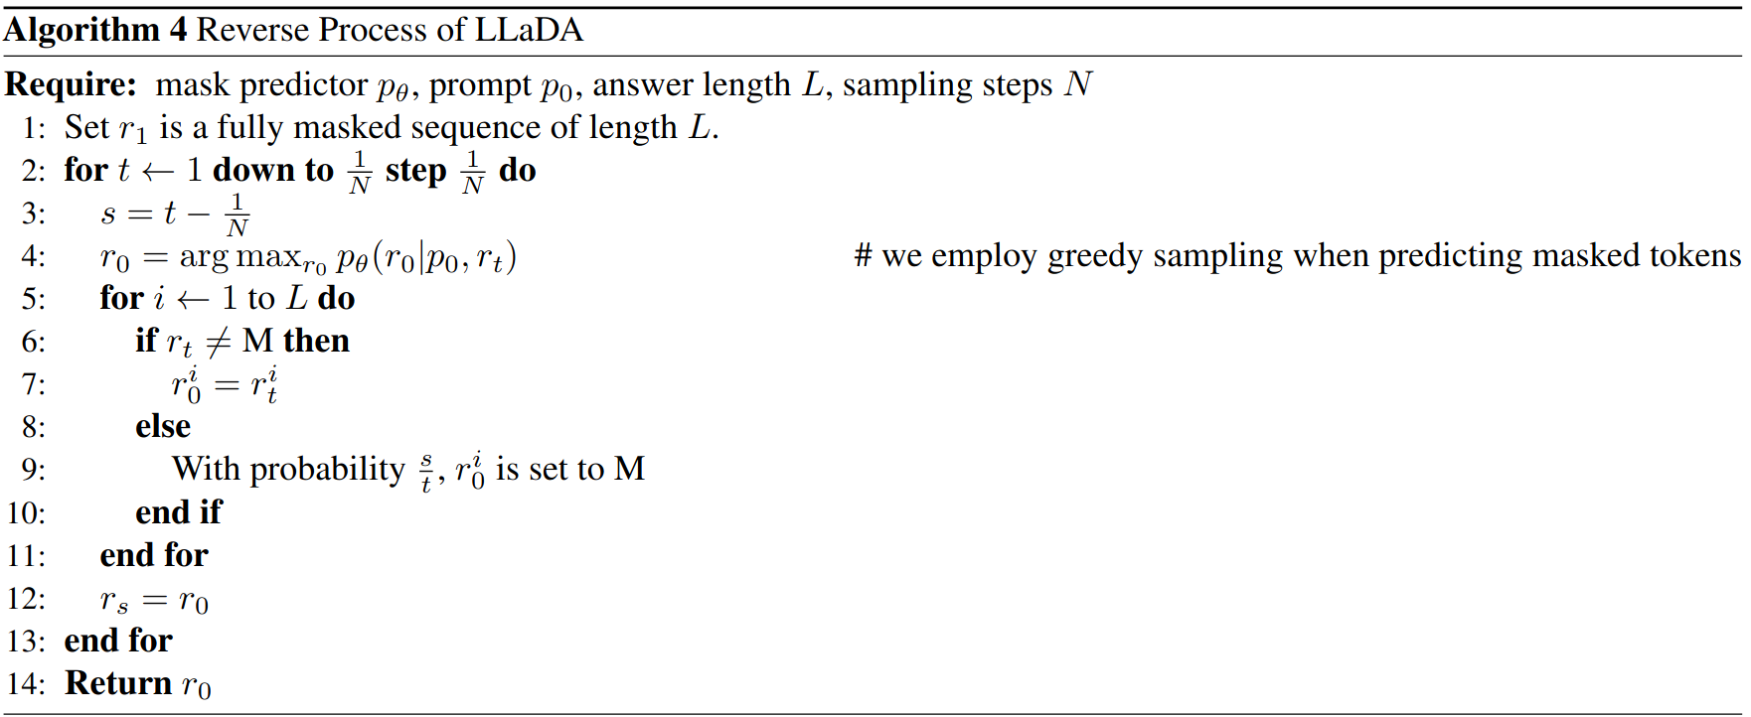

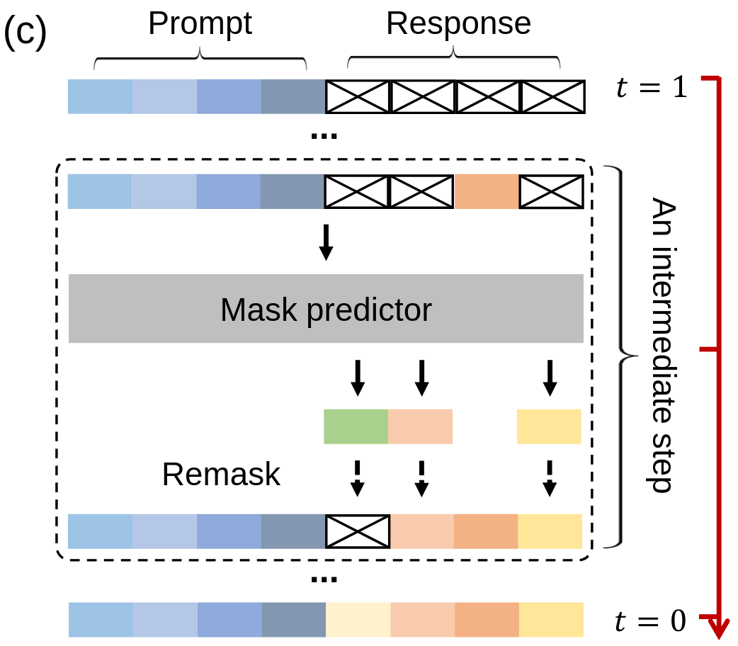
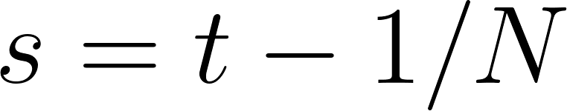

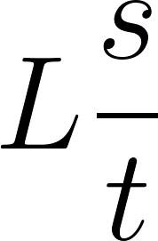
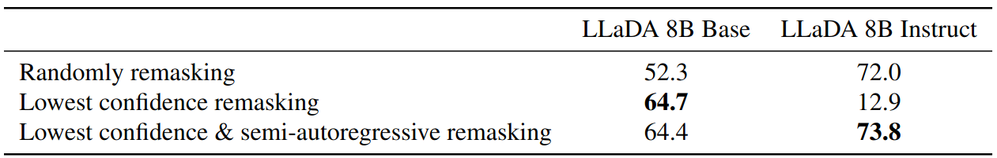
Sampling
Choose sampling steps (tradeoff between efficiency and sample quality) between 1 and 0.
For each , predict then (“at time “), remask the tokens with probability .
Either remask each token independently
Or remask the tokens with lowest logits.

Slide 44
Sampling
Choose sampling steps (tradeoff between efficiency and sample quality) between 1 and 0.
For each , predict then (“at time “), remask the tokens with probability .
Either remask each token independently
Or remask the tokens with lowest logits.

Slide 45
Sampling
Choose sampling steps (tradeoff between efficiency and sample quality) between 1 and 0.
For each , predict then (“at time “), remask the tokens with probability .
Either remask each token independently
Or remask the tokens with lowest logits.

Slide 46
Sampling
Choose sampling steps (tradeoff between efficiency and sample quality) between 1 and 0.
For each , predict then (“at time “), remask the tokens with probability .
Either remask each token independently
Or remask the tokens with lowest logits.

Slide 47
Sampling
Choose sampling steps (tradeoff between efficiency and sample quality) between 1 and 0.
For each , predict then (“at time “), remask the tokens with probability .
Either remask each token independently
Or remask the tokens with lowest logits.
(on GSM8K)

Slide 48
Sampling
Choose sampling steps (tradeoff between efficiency and sample quality) between 1 and 0.
For each , predict then (“at time “), remask the tokens with probability .
Either remask each token independently
Or remask the tokens with lowest logits.
(on GSM8K)

Slide 49
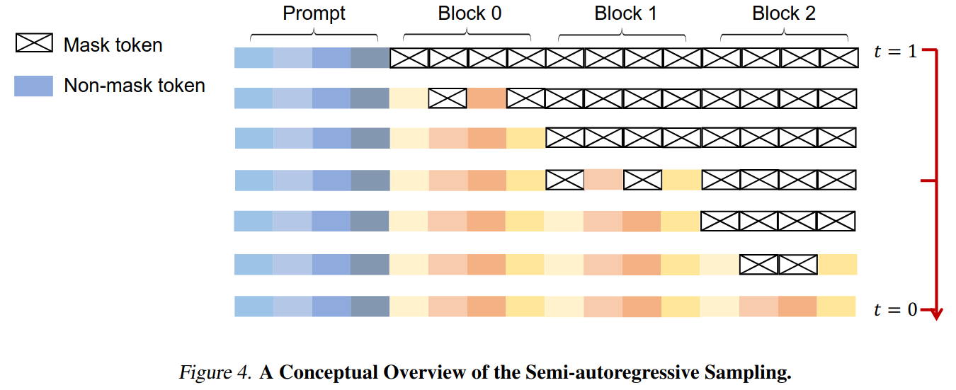
Semi-autoregressive Sampling
Additionally, split the response up into several blocks and generate those from left to right.

Slide 50
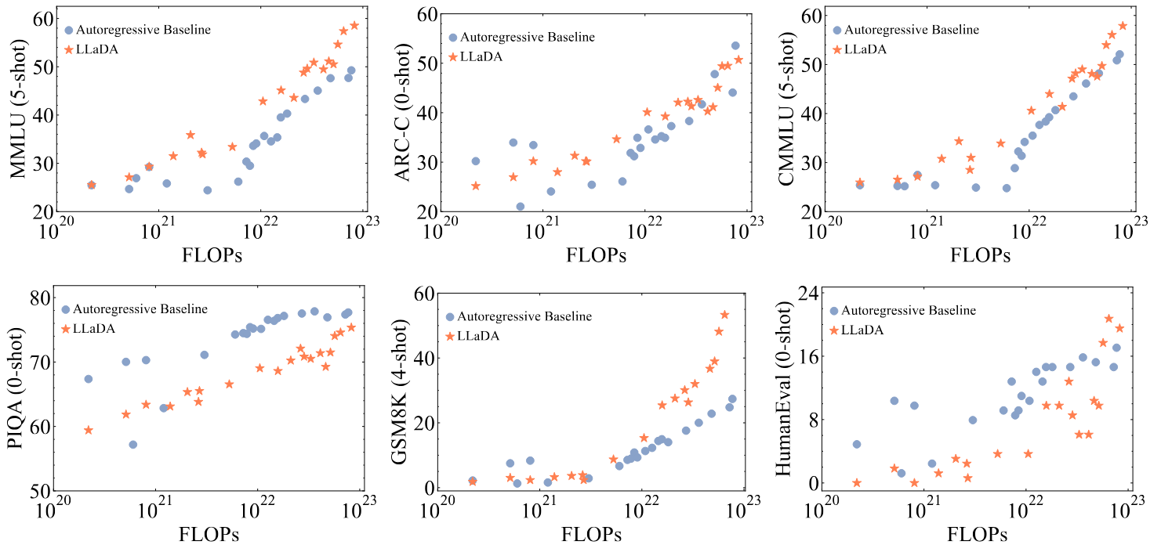
Experiment 1: Scalability
Autoregressive Baseline = LLaDA architecture but autoregressive
Comparable scaling across these 6 tasks

Slide 51
Experiment 1: Scalability
Autoregressive Baseline = LLaDA architecture but autoregressive
Comparable scaling across these 6 tasks

Slide 52
Experiment 1: Scalability
Autoregressive Baseline = LLaDA architecture but autoregressive
Comparable scaling across these 6 tasks

Slide 53
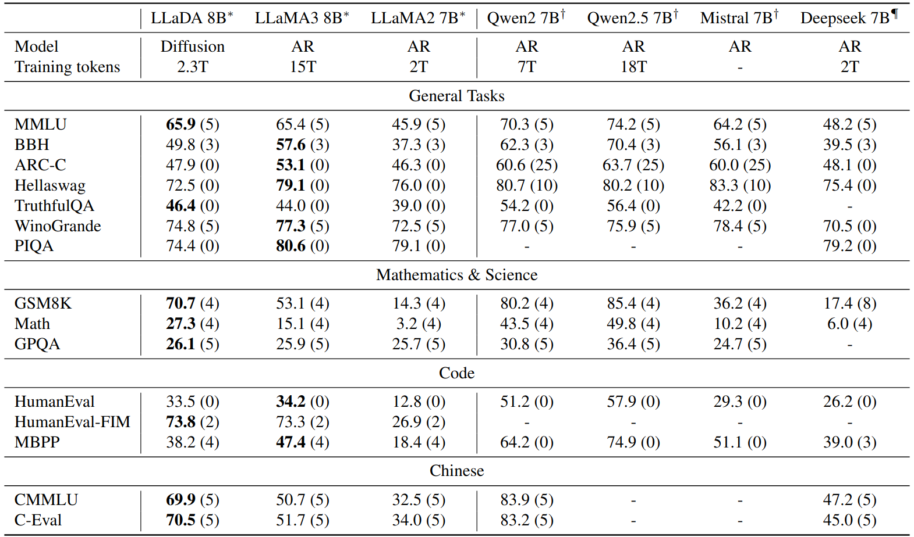
Experiment 2: benchmarks (pretrained)
no error bars >:(

Slide 54
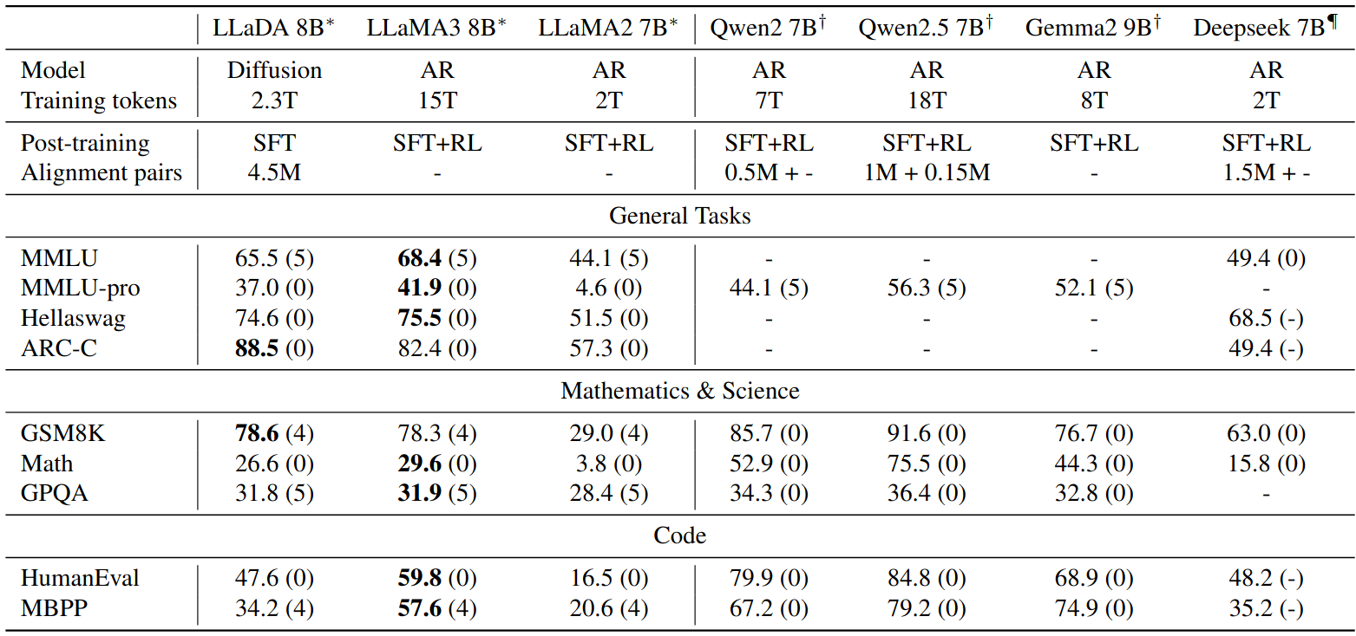
Experiment 3: benchmarks (with post-training)
no error bars >:(
Less impressive?
But note: LLaDA hasn’t had any RL (“we leave RL-based alignment for future work”)
Underwhelming performance on coding tasks, which I thought might be easier for a non-ARM…?

Slide 55
Experiment 3: benchmarks (with post-training)
no error bars >:(
Less impressive?
But note: LLaDA hasn’t had any RL (“we leave RL-based alignment for future work”)
Underwhelming performance on coding tasks, which I thought might be easier for a non-ARM…?

Slide 56
Experiment 3: benchmarks (with post-training)
no error bars >:(
Less impressive?
But note: LLaDA hasn’t had any RL (“we leave RL-based alignment for future work”)
Underwhelming performance on coding tasks, which I thought might be easier for a non-ARM…?

Slide 57
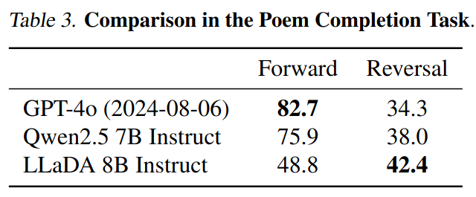
Experiment 4: Reversal Curse fixed
Finetune on 496 famous Chinese poems.
Given a line from a poem, generate either the next or previous line.
Why is it still worse at reversal?

Slide 58
Experiment 4: Reversal Curse fixed
Finetune on 496 famous Chinese poems.
Given a line from a poem, generate either the next or previous line (zero-shot).
Why is it still worse at reversal?

Slide 59
Experiment 4: Reversal Curse fixed
Finetune on 496 famous Chinese poems.
Given a line from a poem, generate either the next or previous line (zero-shot).
Why is it still worse at reversal?

Slide 60
Experiment 4: Reversal Curse fixed
Finetune on 496 famous Chinese poems.
Given a line from a poem, generate either the next or previous line (zero-shot).
Why is it still worse at reversal?

Slide 61

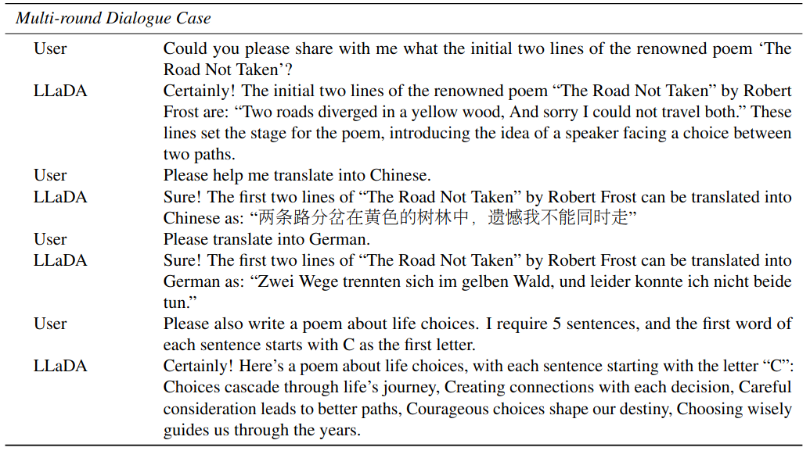
Conclusion
A nice direction to go in, we’ll see if it becomes useful (I’m not convinced)
Authors are keen to show that after finetuning it is semi-decent in conversation
Unlikely that many people other than these authors (who clearly have tons of compute) will be willing to keep scaling these up

Slide 62
Conclusion
A nice direction to go in, we’ll see if it becomes useful (I’m not convinced)
Authors are keen to show that after finetuning it is semi-decent in conversation
Unlikely that many people other than these authors (who clearly have tons of compute) will be willing to keep scaling these up

Slide 63
Conclusion
A nice direction to go in, we’ll see if it becomes useful (I’m not convinced)
Authors are keen to show that after finetuning it is semi-decent in conversation
Unlikely that many people other than these authors (who clearly have tons of compute) will be willing to keep scaling these up

Slide 64
References
Austin, Jacob, Daniel D. Johnson, Jonathan Ho, Daniel Tarlow, and Rianne van den Berg. 2023. ‘Structured Denoising Diffusion Models in Discrete State-Spaces’. arXiv. https://doi.org/10.48550/arXiv.2107.03006.
Delétang, Grégoire, Anian Ruoss, Paul-Ambroise Duquenne, Elliot Catt, Tim Genewein, Christopher Mattern, Jordi Grau-Moya, et al. 2024. ‘Language Modeling Is Compression’. arXiv. https://doi.org/10.48550/arXiv.2309.10668.
Li, Xiang Lisa, John Thickstun, Ishaan Gulrajani, Percy Liang, and Tatsunori B. Hashimoto. 2022. ‘Diffusion-LM Improves Controllable Text Generation’. arXiv. https://doi.org/10.48550/arXiv.2205.14217.
Lin, Zhenghao, Yeyun Gong, Yelong Shen, Tong Wu, Zhihao Fan, Chen Lin, Nan Duan, and Weizhu Chen. 2023. ‘Text Generation with Diffusion Language Models: A Pre-Training Approach with Continuous Paragraph Denoise’. arXiv. https://doi.org/10.48550/arXiv.2212.11685.
Lou, Aaron, Chenlin Meng, and Stefano Ermon. 2024. ‘Discrete Diffusion Modeling by Estimating the Ratios of the Data Distribution’. arXiv. https://doi.org/10.48550/arXiv.2310.16834.
Nie, Shen, Fengqi Zhu, Chao Du, Tianyu Pang, Qian Liu, Guangtao Zeng, Min Lin, and Chongxuan Li. 2024. ‘Scaling up Masked Diffusion Models on Text’. arXiv. https://doi.org/10.48550/arXiv.2410.18514.
Nie, Shen, Fengqi Zhu, Zebin You, Xiaolu Zhang, Jingyang Ou, Jun Hu, Jun Zhou, Yankai Lin, Ji-Rong Wen, and Chongxuan Li. 2025. ‘Large Language Diffusion Models’. arXiv. https://doi.org/10.48550/arXiv.2502.09992.
Ye, Jiasheng, Zaixiang Zheng, Yu Bao, Lihua Qian, and Mingxuan Wang. 2024. ‘DINOISER: Diffused Conditional Sequence Learning by Manipulating Noises’. arXiv. https://doi.org/10.48550/arXiv.2302.10025.

Slide 65
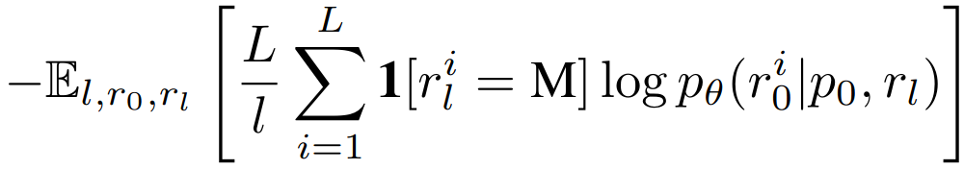
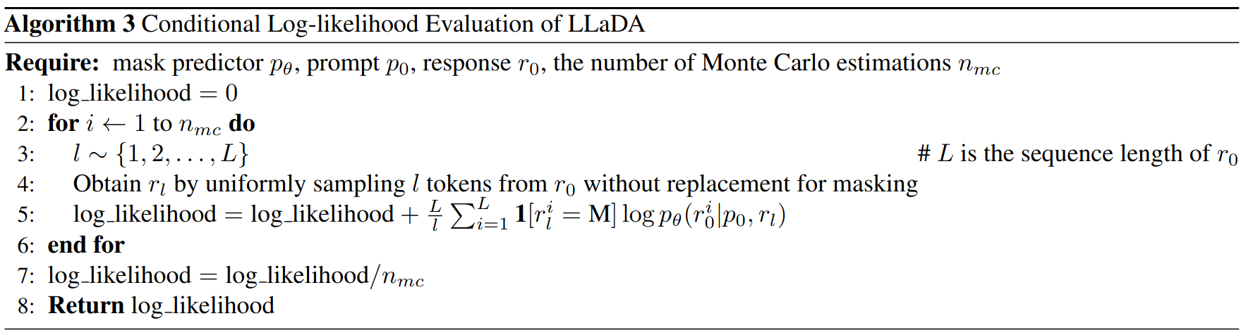
Conditional Likelihood Evaluation
Also actually use this more stable loss function when doing conditional likelihood evaluation (rather than text generation), where

Slide 66
Comparison Against DeepSeekV3 Training
DeepSeek V3 – 617B MoE (37B per token)
15T tokens,
2.8 million H800 hours
“~$5.6M”
LLaDA 8B
2.3T tokens
0.13 million H800 GPU hours
~$0.26M?

